Slide 1
WennBerg InternatioNAL Collaborative, SPRING POLICY MEETING, LUCERNE, April 10 - 12
Small Area Variation in the Rates of Vitamin D Testing in Switzerland – A Retrospective Database Study
Maria Trottmann, PhD, SWICA Health Services Research Eva Blozik, Prof. Dr. med. MPH, Team Lead SWICA Health Services Research

Slide 2
Background and Aim
Background
Population based screening for vitamin D deficiency is not recommended. Still, testing is frequently observed in Switzerland and rates are still increasing.
Aim
Analyse the small area variation in the share of tested persons and number of tests per person.
Analyse the potential influence of non-medical variables such as the choice of insurance contract and provider density in the area.

Slide 3
Data & Data PrePARATION
Claims data from SWICA health organization, covering > 800.000 lives
A stratified sample of about 160.000 adults was taken, representing the Swiss population according to age group and area of residence.¹
Excluding people without physician contacts ² reduced the sample to around 130.000 adults per year.
Each patient was assigned to one of 102 areas³ as his or her «main primary care area»
> 80% of the patients had a «most frequented» provider area
If the patient had no «most frequented» provider area (i.e. several regions with equal shares), but one of the areas in question is his or her area of residence, this area is used.
3,5% of patients couldn’t be assigned and were excluded, reducing the dataset to around 126.000
For calculating provider density, total tariff points for physician services billed to mandatory insurance were considered (SASIS data pool). A full time equivalent is calculated as the 60%-percentile in each speciality.
¹ The area here is the «greater statistical area» as defined by the Federal Statistical Office, Official data from risk adjustment was used for stratification.
² A bill with either consultation or a prescription for a lab test was counted as a relevant physician contact here.
³ Defined by the Federal Statistical Office, see https://www.bfs.admin.ch/bfs/de/home/grundlagen/raumgliederungen.html

Slide 4
Methods & Risk adjustment
Logistic regression on propensity of being tested, Odds Ratios
male | 0,60 | (0,58-0,62)
age 26-30 | 1,28 | (1,16-1,4)
age 31-35 | 1,46 | (1,33-1,6)
…
age 81-85 | 1,86 | (1,69-2,05)
age 86-90 | 1,56 | (1,4-1,74)
age 91- | 1,14 | (0,98-1,31)
high deductible | 0,65 | (0,63-0,67)
HMO model | 0,81 | (0,78-0,84)
telemedicine model | 0,92 | (0,89-0,96)
private hospital insurance | 1,02 | (0,99-1,06)
chronic illness (1-2 PCG) | 1,37 | (1,32-1,42)
multimorbidity (3+ PCG) | 1,71 | (1,52-1,91)
A logistic regression was used to adjust testing rates
positive association with age and morbidity
negative association with being male, having a high deductible, being enrolled in a HMO or telemedicine plan.
Standardization of the rate in region g
$R_{g}^{Standardized}=\frac{R_{g}^{Observed }}{R_{g}^{Predicted }}$ *${ R}_{CH}^{Observed }$
The 95%-Confidence interval was calculated assuming a binomial distribution
$R_{g}^{Standardized}=\frac{R_{g}^{Observed }±(sqrt\left(\frac{R_{g}^{Observed } ∗ \left(1−R_{g}^{Observed }\right)}{n}\right)∗1.96)}{R_{g}^{Predicted }}$ *${ R}_{CH}^{Observed }$
Year = 2019 N = 126.046

Slide 5
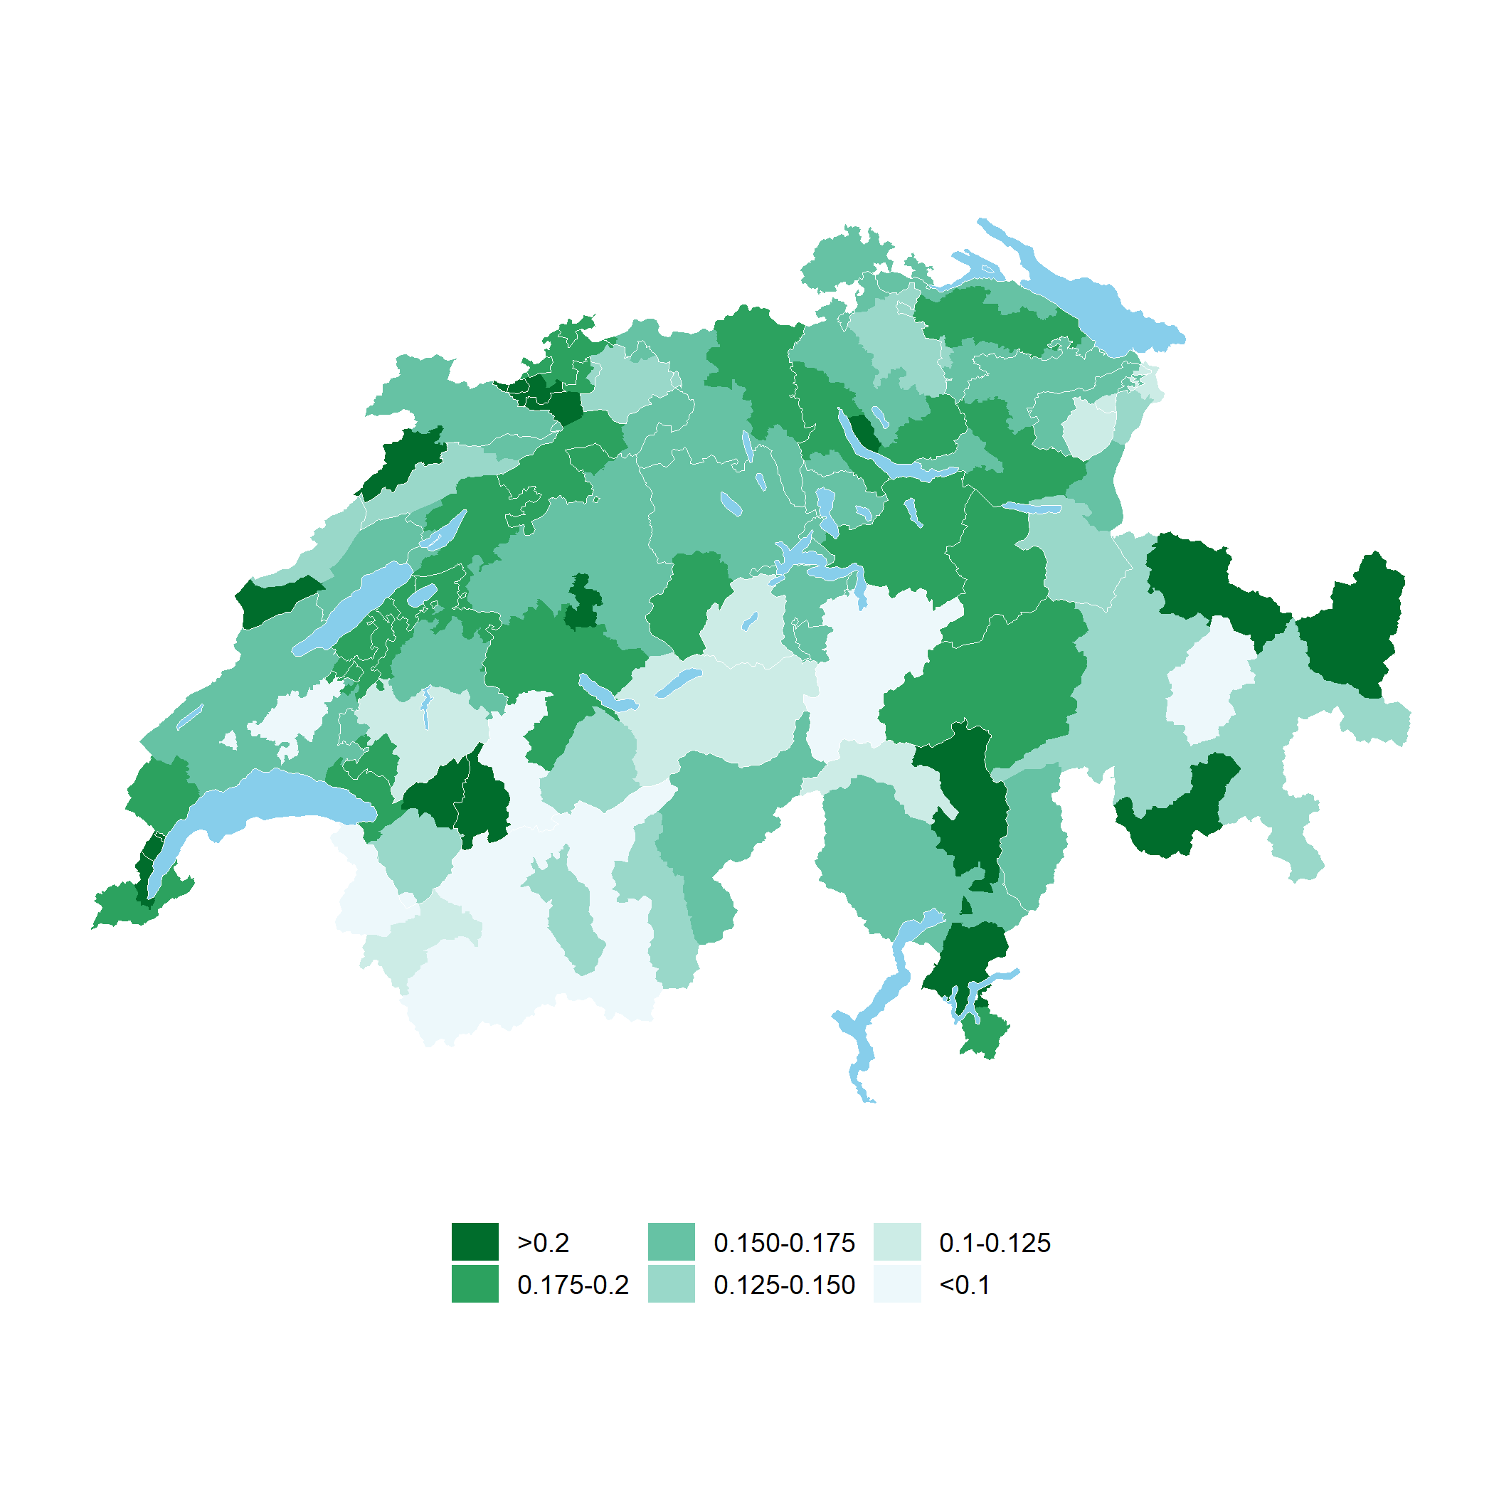
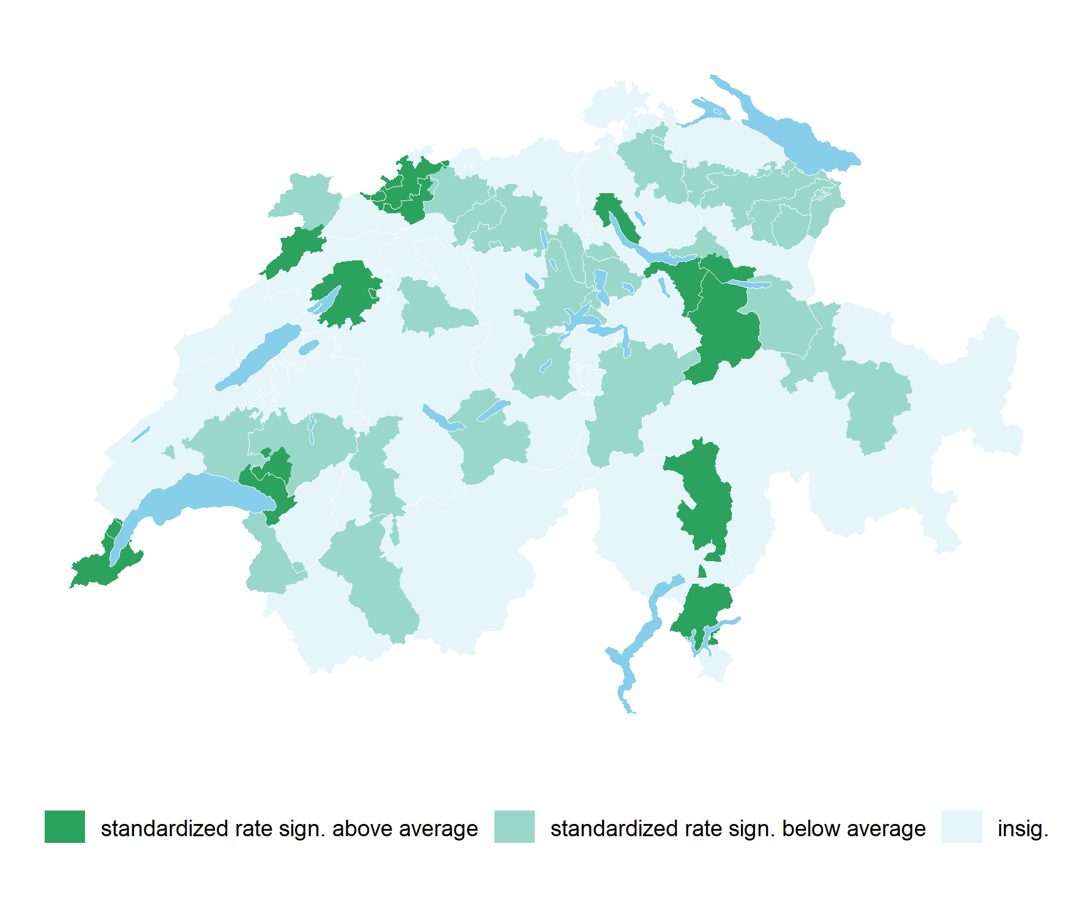
Results
Standardized rates,
Sign. different from Swiss average
Standardized rates
Swiss average rate: 0.175
Adding an indicator for high provider density areas to the logistic regression showed a positive association: OR 1.11 (1.08 - 1.14)

Slide 6
Conclusions
Measurement of Vitamin D levels is frequent in Switzerland and testing rates are still increasing.
Testing rates are positively associated with being female, older, suffering from chronic conditions, and also with living in an area with high provider density, indicating unwarranted variation.
Testing was negatively associated with having a high deductible and being enrolled in a HMO or telemedicine plan indicating that health system factors (such as quality assurance measures of healthcare providers) seem to influence provision of non- recommended tests.
After adjusting for patient characteristics, considerable regional variation in testing rates remain, but no clear regional patterns emerged.

