Slide 1
The impact of primary care physician density on perinatal health.
Evidence from a natural experiment
Jonas M. Kinge og Jostein Grytten
Norwegian Institute of Public Health / University of Oslo
WIC meeting Lucerne April 2022

Slide 2
Background
Focus of the present work
  Examines the effect of primary care physician density on perinatal health
Strengths of the present work
  Exploits a natural experiment that has the potential to provide causal estimates
  Carried out within an institutional setting with a strong focus on primary care, including antenatal care.
  Use of register data that are representative of the study population

Slide 3
Background
Previous research based on cross-sectional studies
  Mostly correlation studies
  Different measures of health outcomes have been regressed on primary care physican density. Mixed findings
  The studies suffer from bias due to reversed causality and omitted variables
    Often insufficent control for health care needs and socio-demographic characteristics of the population

Slide 4

The antenatal care programme in Norway
Provided almost exclusively by primary care physicians
  Norway’s population: 5.2 million
  Number of man-labour years of primary care physicians: 4900
  Primary care physicians act as gatekeepers to specialist care
  Number of deliveries per year: 60 000
Comprehensive – all pregnant women are entitled to ten antenatal visits
  The content of each visit is described in detail in the National Guidelines for Antenatal Care
  Ultrasound examination in week 17 or 18
Free of charge

Slide 5
  Mechanisms - more primary care physicians leads to:
Better access to antenatal care
Improvements in the quality of each antenatal visit
Benefits
  High risk pregnancies can be identified at an early stage
    Pregnant women can then be referred for further examination and adequate care
  More time for health education
    If followed by pregnant women lead to improved health of the child

Slide 6

The experiment – introduction of state policy
Early 1990 – a shortage of primary care physicians in rural areas
State policy introduced in 1992:
  Primary care physicans who chose to work in selected municipalities with physician shortage were given an annual reduction in their student loan of 10 %
  An upward ceiling on the amount that could be deducted (EUR 1 900)
  Encompassed 20 selected remote municipalities

Slide 7
Comparison group
  Small and medium-sized municipalities from all counties in Norway (n=328)
  The mean number of deliveries in the comparison group was similar to the mean number of deliveries in the treatment group (mean = 30)

Slide 8
The number of man-labour years of primary care physicians per 1000 deliveries
Phase-in
Post-reform
treatment municipalities
comparison municipalities
the whole country
Source: Norwegian Centre for Research data

Slide 9
Number of medical students who finished training
Pre-reform
Phase-in
Post-reform
Source: Statistics Norway

Slide 10
Baseline model
Outcomes
  Foetal death: A baby born with no sign of life at or after 28 completed weeks of gestation
  Birth weight in grammes
Difference-in-difference design with two groups
  Post-period = 1: birth year [1998, 2007]
  Reference group: birth year [1986, 1991]
  Fixed effects for municipality and year of delivery
Analyses:
  Linear probability model and OLS. Clustering at the municipal level
Data: Medical Birth Registry of Norway (MFR) and Statistics Norway

Slide 11
Key results - improvements in perinatal health

Slide 12
Sensitivity analysis – risk factors of the mother
In both groups, the proportion of pregnant women with risk factors:
  some factors increased over time
  some factors decreased over time
Ideally, the change in the proportion of pregnant women with risk factors should be in the same order of mangitude in both groups
MBR - risk factors of the mother
  Mother’s age, highest education, immigrant background and marital status
  Whether she had previously had a foetus that had died, or previously had a Cesarean delivery
  Whether the pregnancy was her first (null parity)
  Whether she had a chronic disease, preeclampsia or bleeding during pregnancy

Slide 13
Inclusion of risk factors of the mother

Slide 14
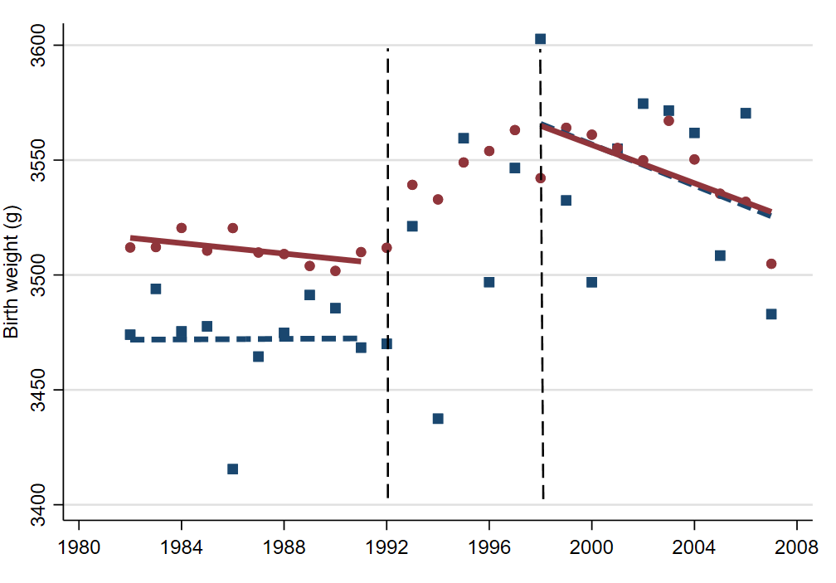
Assumption: Parallel pre-trends - birth weight
Pre-reform
Phase-in
Post-reform

Slide 15
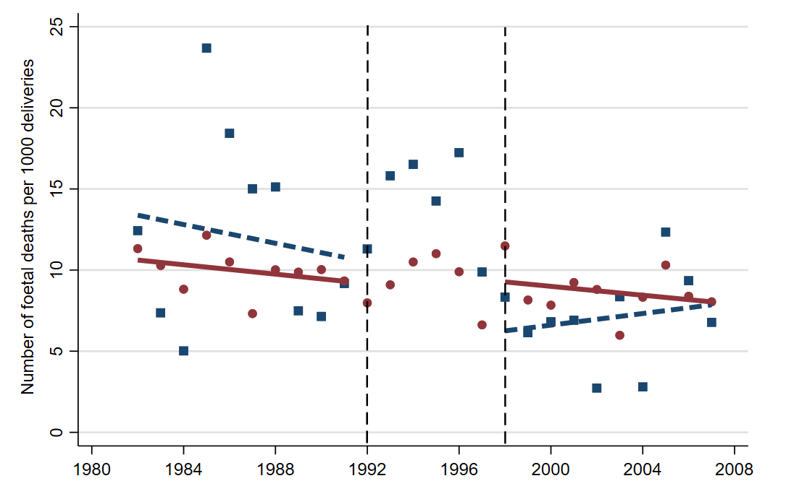
Assumption: Parallel pre-trends - foetal deaths
Pre-reform
Phase-in
Post-reform

Slide 16
Mechanisms
Data: Norwegian Health Economics Administration (2006-2017)
  Includes all patients who receive primary physician services, including all pregnant women
Outcomes
  Number of antenatal visits per delivery (access)
  The probability of having an antenatal visit lasting more than 20 minutes (quality)
    Used for patients who are time-consuming to treat
Analyses
  OLS with fixed effects for municipality and year

Slide 17
Mechanisms - results
An increase in primary physician density of 1% led to:
  Better access
    An increase in antenatal visits per delivery of 0.12%
  Improvements in the quality of each visit
    An increase in the probability of having an antenatal visit lasting more than 20 minutes of 0.32

Slide 18
Conclusions
An increase in primary care physician density improves perinatal health outcomes:
  fewer foetal deaths
  an increase in birth weight
Most likely, this is because more primary care physicians leads to better access to antenatal care and improvements in the quality of each antenatal visit
The analyses have been carried out using a natural experiment that had the potential to provide causal estimates
Sensitivity analyses supported the main findings
Our results support a policy for strengthening primary health care

