Slide 1
Where you live is how you die*: should geography be destiny?
Ethical reflections upon regional variation in euthanasia
Luzern, April 10 2022
A. Stef Groenewoud, Gert P. Westert, Theo A. Boer
*After: McKinney, M., Where you live = how you die: ‘Geography is destiny’ for end-of-life care, which often is costly, aggressive. Mod Healthc, 2010. 40(47): p. 6-7, 16, 1

Slide 2
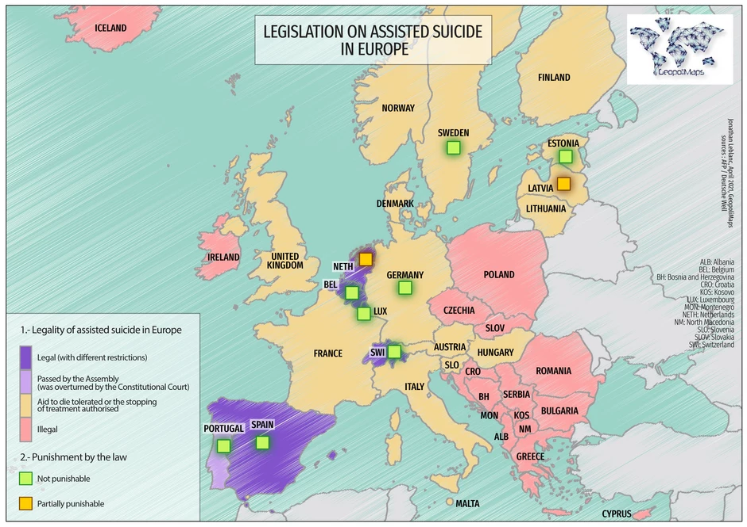
Euthanasia in the Netherlands
Due care criteria:
voluntary and well-considered request
unbearable suffering, no prospect of improvement
informed patient
absence of reasonable alternatives
independent physician is consulted
medically and technically appropriate

Slide 3
Euthanasia in the Netherlands

Slide 4
Euthanasia in the Netherlands

Slide 5
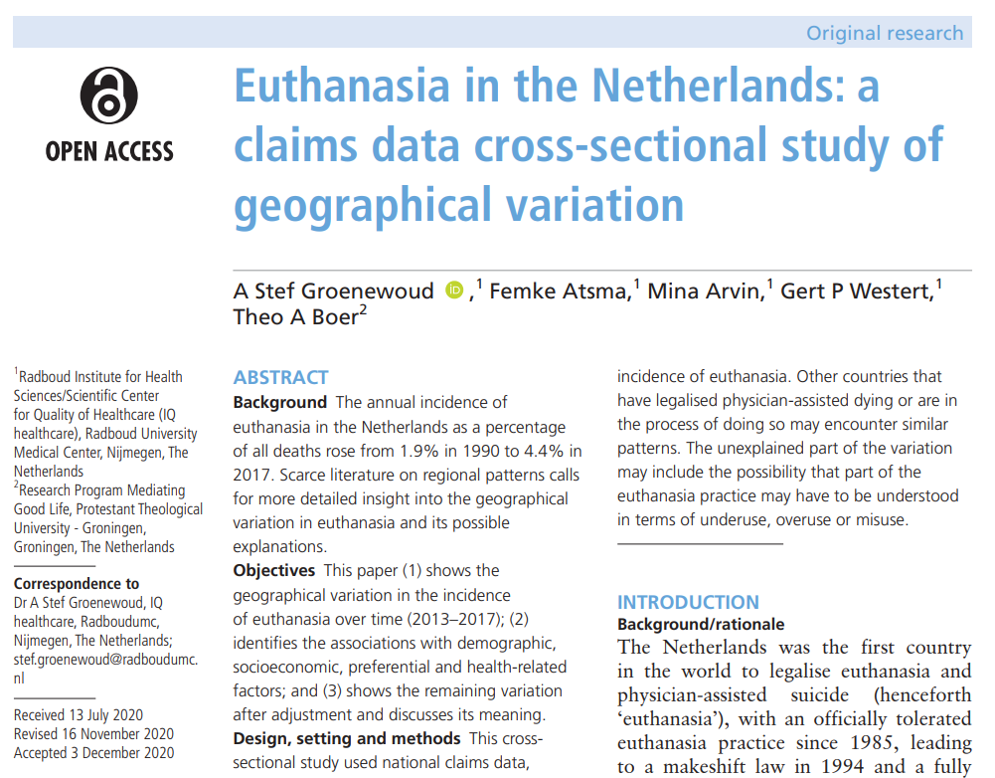
Regional variation euthanasia

Slide 6
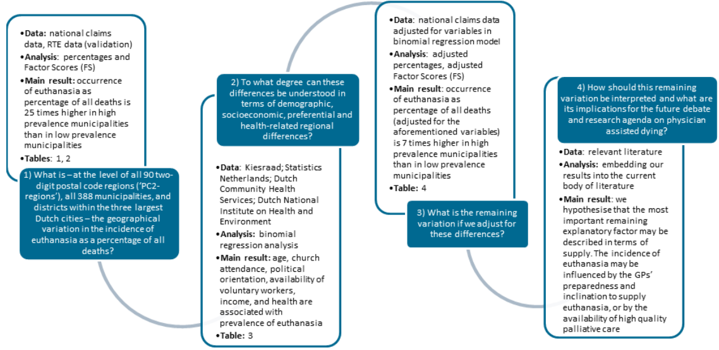
Regional variation euthanasia

Slide 7
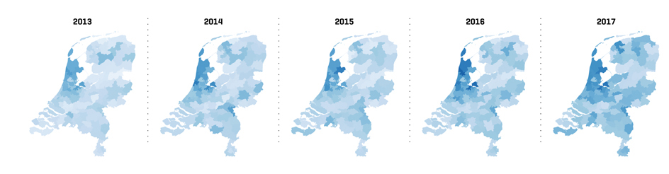
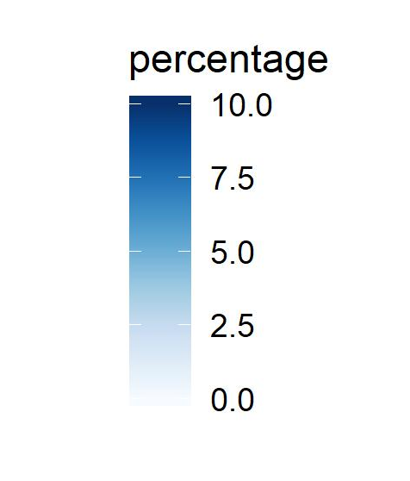
Regional variation euthanasia
2-digit postal codes: 90 regions

Slide 9
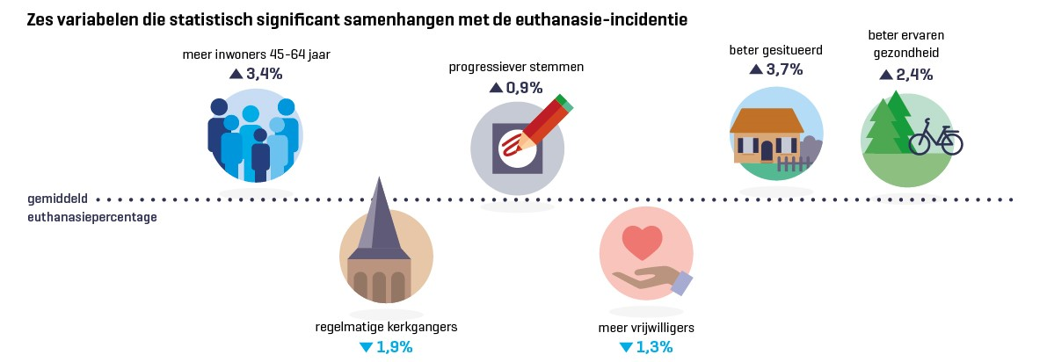
Six associated variables
age
income
self experienced
health
voting progressive parties
average euthanasia
percentage
frequent churchgoers
availability of voluntary workers

Slide 10
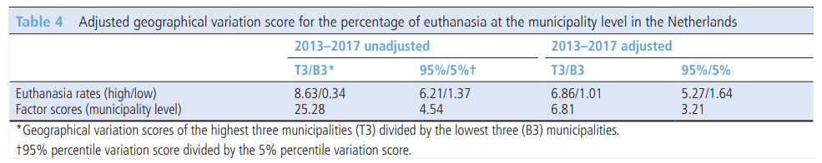
Unexplained variation after adjustment: FS 7

Slide 11
Our closing hypothesis was:
If (based on Wennbergs* deductive model for the interpreation of practice vatiation) regional variation is only warranted if it is caused by…
Differences in health and disease
Differences in preferences
And if all other variation is unwarranted and often caused by…
Differences in supply
Assuming that we have taken into account relevant factors (1,2) then at least part of the remaining variation may be supplier induced and thus unwarranted.
This may mean:
some GPs are more, others are less prepared to discuss and perform euthanasia, and / or
in some municipalities alternative treatments at the end of life are less available / accessible
*The deductive model for interpretation can be found in:
Wennberg, J.E., Unwarranted variations in healthcare delivery: implications for academic medical centres. British Medical Journal, 2002. 325(7370): p. 961-964.
Wennberg, J.E. and ProQuest (Firm), Tracking medicine a researcher’s quest to understand health care. 2010, Oxford University Press,: Oxford. p. xviii, 319 p.
Mulley, A.G., Inconvenient truths about supplier induced demand and unwarranted variation in medical practice. BMJ, 2009. 339: p. b4073.

Slide 12
Question:
Are current frameworks* for the interpretation of regional variation in health care utilization applicable to / suitable for ethically controversial procedures such as euthanasia?
* Frameworks we looked at are:
Wennberg, J.E. and ProQuest (Firm), Tracking medicine a researcher’s quest to understand health care. 2010, Oxford University Press,: Oxford. p. xviii, 319 p.
Mercuri, M. and A. Gafni, Medical practice variations: what the literature tells us (or does not) about what are warranted and unwarranted variations. Journal of Evaluation in Clinical Practice, 2011. 17(4): p. 671-677.
Goodman, D.C., Unwarranted variation in pediatric medical care. Pediatr Clin North Am, 2009. 56(4): p. 745-55.
Bojakowski, S., Managing the paradox between equality and diversity in healthcare: Unwarranted vs warranted variations. Journal of Management & Marketing in Healthcare, 2010. 3(4): p. 241-247.
Sepucha, K., E. Ozanne, and A.G. Mulley, Jr., Doing the right thing: systems support for decision quality in cancer care. Ann Behav Med, 2006. 32(3): p. 172-8.
Birkmeyer, J.D., et al., Understanding of regional variation in the use of surgery. Lancet, 2013. 382(9898): p. 1121-9.
Westert, G.P. and P.P. Groenewegen, Medical practice variations: changing the theoretical approach. Scandinavian Journal of Public Health, 1999. 27(3): p. 173-180.
de Jong, J.D., P.P. Groenewegen, and G.P. Westert, Sociological Model for Understanding Medical Practice Variations, in Medical Practice Variations, A. Johnson and T.A. Stukel, Editors. 2016, Springer US: Boston, MA. p. 25-39.

Slide 13
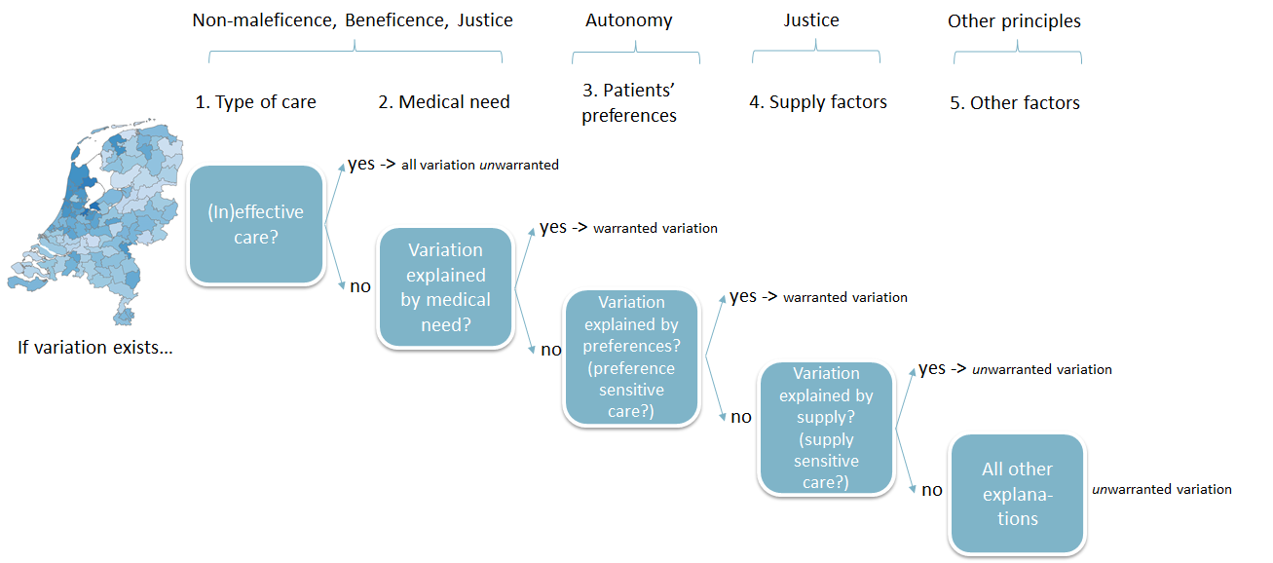
An integrated medical ethical model for the deductive interpretation of regional variation

Slide 14
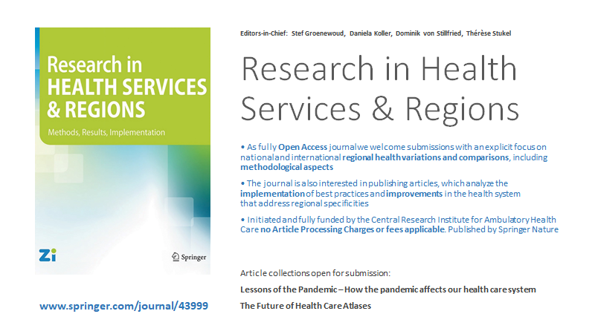
This paper will be submitted to:

